Slide 1


Introduction to Cyberspace Security
网络空间安全导论
Lecture 5: Computer Networks and Network Security
– Layered Architecture; Network Verification
第5讲 计算机网络与安全 – 网络分层架构；网络验证
Instructor：Qiao Xiang
Oct. 26, 2021

Slide 2
Outline
Recap
Layered architecture
Network verification
This deck of slides are heavily based on CPSC 433/533 and CPSC 434/534 at Yale University, by courtesy of Dr. Y. Richard Yang, and the conference slides of " A General Approach to Network Configuration Verification", from Dr. Ryan Beckett.
2

Slide 3
Recap
A protocol defines the format and the order of messages exchanged between two or more communicating entities, as well as the actions taken on the transmission or receipt of a message or other events.
Key Internet milestones and their implications:
ARPANET is sponsored by ARPA
The initial IMPs (routers) were made by a small company
Many networks
Commercialization
design should survive failures
keep the network simple
internetworking: need a network to connect networks
architecture supporting decentralized, autonomous systems
3

Slide 4
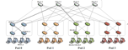
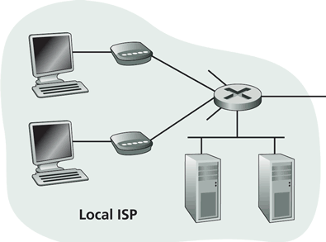
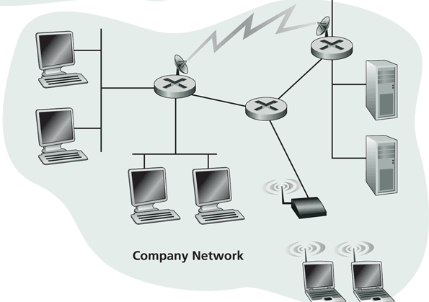
Recap: Internet Physical Infrastructure
Residential access
Cable, Fiber, DSL, Wireless
ISP
Backbone ISP
ISP
The Internet is a network of networks
Each individually administrated network is called an Autonomous System (AS)
data center
Campus access, e.g.,
Ethernet
Wireless
4

Slide 5
Outline
Recap
Layered architecture
what is layering?
why layering?
ISO/OSI layering and Internet layering
5

Slide 6
What is Layering?
A technique to organize a networked system into a succession of logically distinct entities, such that the service provided by one entity is solely based on the service provided by the previous (lower level) entity.
Application
Application
Transport
Transport
Network
Network
Network
Datalink
Datalink
Datalink
Physical
Physical
Physical
Physical medium
6

Slide 7
Outline
Recap
Layered architecture
what is layering?
why layering?
7

Slide 8
Why Layering?
Networks are complex !
many “pieces”:
hardware
hosts
routers
links of various media
software
applications
infrastructure
Dealing with complex systems: explicit structure allows identification of the relationship among a complex system’s pieces
layered reference model for discussion
Modularization eases maintenance, updating of system:
change of implementation of a layer’s service transparent to rest of system, e.g., changes in routing protocol doesn’t affect rest of system
8

Slide 9
An Example: No Layering
Application
Telnet
FTP
HTTP
Transmission
Media
Ether-net
Fiber
optic
Wireless
No layering: each new application has to be re-implemented for every network technology !
9

Slide 10
An Example: Benefit of Layering
Introducing an intermediate layer provides a common abstraction for network technologies
Application
Telnet
FTP
HTTP
Transport
& Network
Transmission
Media
Ethernet
Fiber
optic
Wireless
10

Slide 11
ISO/OSI Concepts
ISO – International Standard Organization
OSI – Open System Interconnection
Service – says what a layer does
Interface – says how to access the service
Protocol – specifies how the service is implemented
a set of rules and formats that govern the communications between two or more peers
11

Slide 12
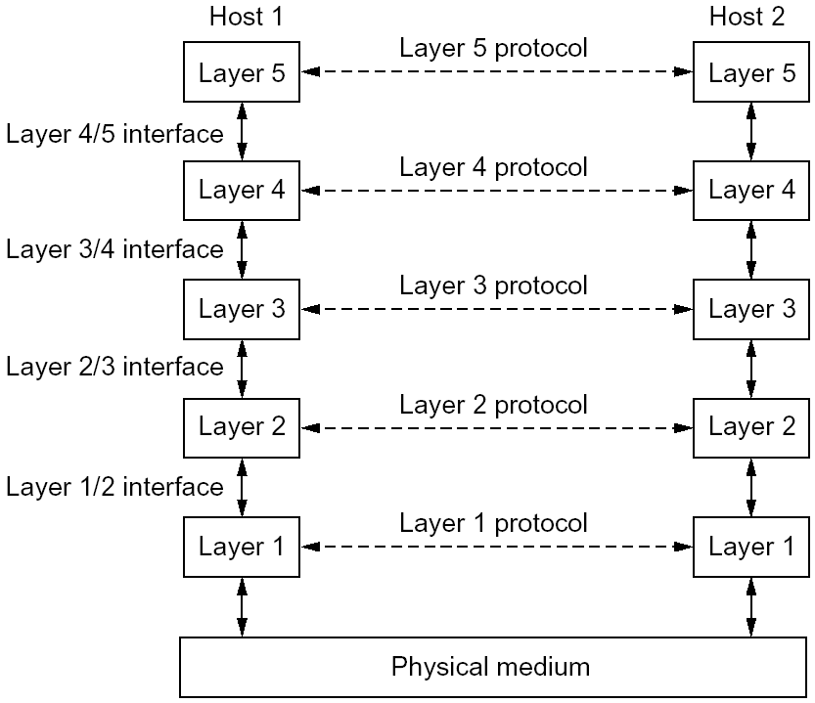
An Example of Layering
12

Slide 13
An Example of Layering
13

Slide 14
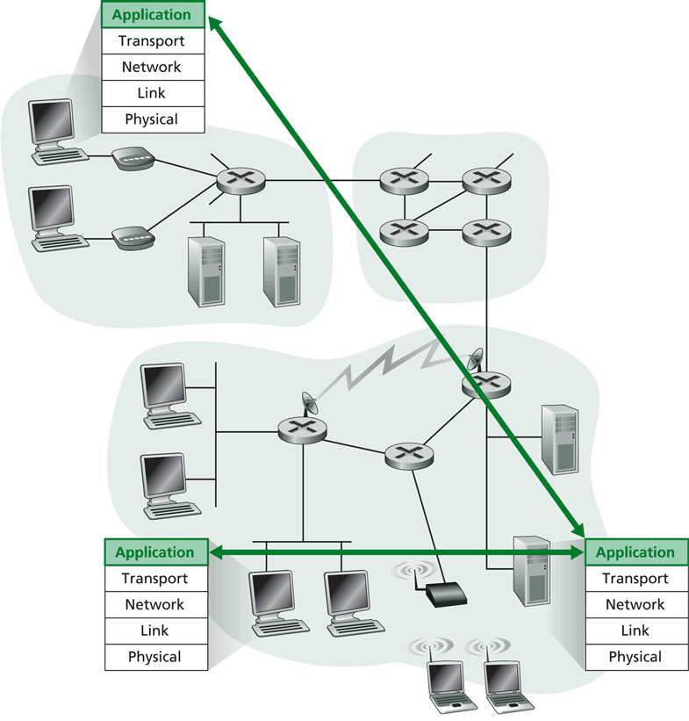
Layering -> Logical Communication
E.g.: application
provide services to users
application protocol:
send messages to peer
for example, HELO, MAIL FROM, RCPT TO are messages between two SMTP peers
14

Slide 15
Layering: Logical Communication
data
E.g.: transport
Trans. msg for app
Transport protocol
add control info to form “segment”
send segment to peer
wait for peer to ack receipt; if no ack, retransmit
application
transport
network
link
physical
transport
ack
network
link
physical
application
transport
network
link
physical
data
data
application
transport
network
link
physical
application
transport
network
link
physical
transport
15

Slide 16
Layering: Physical Communication
data
application
transport
network
link
physical
network
link
physical
application
transport
network
link
physical
data
application
transport
network
link
physical
application
transport
network
link
physical
16

Slide 17
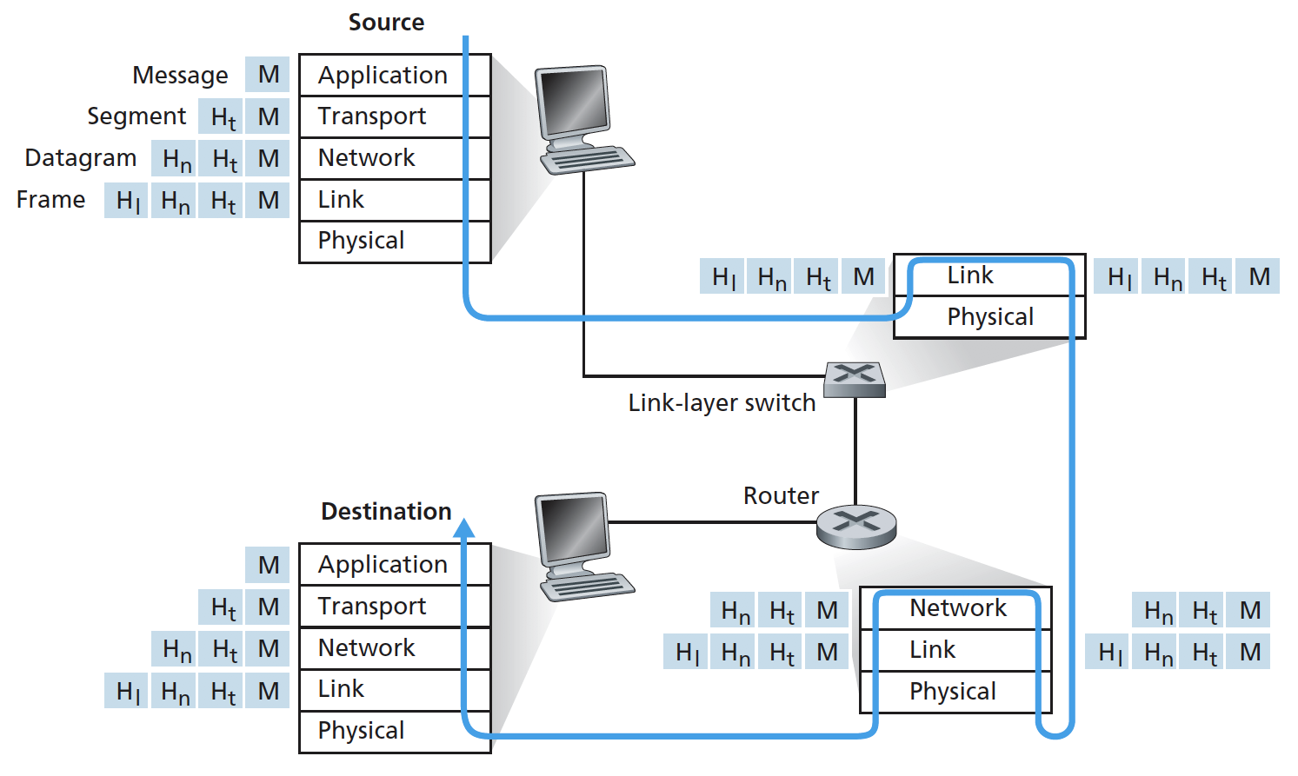
Protocol Layering and Meta Data
Each layer takes data from above
adds header (meta) information to its peer to create new data unit
passes new data unit to layer below
17

Slide 18
Packet as a Stack in a Layered Architecture
Application
Application
Transport
Transport
Network
Network
Network
Datalink
Datalink
Datalink
Physical
Physical
Physical
Physical medium
18

Slide 19
Some Implications of Layered Architecture
A packet as a stack container
Each layer needs multiplexing and demultiplexing to serve layer above
…
Hn-1
Hn
Ln
Has a field to indicate which higher layer requires the service
Ln-1
19

Slide 20
Outline
Recap
Layered architecture
what is layering?
why layering?
ISO/OSI layering and Internet layering
20

Slide 21
ISO/OSI Reference Model
Seven layers
highest four layers are implemented in host
Application
Application
Presentation
Presentation
Session
Session
Transport
Transport
Network
Network
Network
Datalink
Datalink
Datalink
Physical
Physical
Physical
Physical medium
21

Slide 22
Internet Layering
Five layers
highest two layers are implemented in host
Application
Application
Transport
Transport
Network
Network
Network
Datalink
Datalink
Datalink
Physical
Physical
Physical
Physical medium
22

Slide 23
Internet Protocol Layers
Five layers
Application: applications
ftp, smtp, http, p2p, IP telephony, blockchain, MapReduce, …
Transport: host-host data transfer
tcp (reliable), udp (not reliable)
Network: routing of datagram from source to destination
ipv4, ipv6
Link: data transfer between neighboring network elements
ethernet, 802.11, cable, DSL, …
Physical: bits “on the wire”
cable, wireless, optical fiber
application
transport
network
link
physical
23

Slide 24
The Hourglass Architecture of the Internet
Email
WWW
FTP
Telnet
TCP
UDP
end users
IP4
network
infrastructure
Ethernet
Wireless
Cable/DSL
24

Slide 25
Summary: The Big Picture of the Internet
Hosts and routers:
~ 1 bil. hosts
autonomous systems organized roughly hierarchical
backbone links at 100 Gbps
Software:
datagram switching with virtual circuit support at backbone
layered network architecture
use end-to-end arguments to determine the services provided by each layer
the hourglass architecture of the Internet
Email
WWW
FTP
Telnet
SSL
TCP
UDP
IP4/6
Ethernet
Wireless
Cable/DSL
25

Slide 26
Outline
Recap
Layered architecture
what is layering?
why layering?
ISO/OSI layering and Internet layering
Network Verification
26

Slide 27
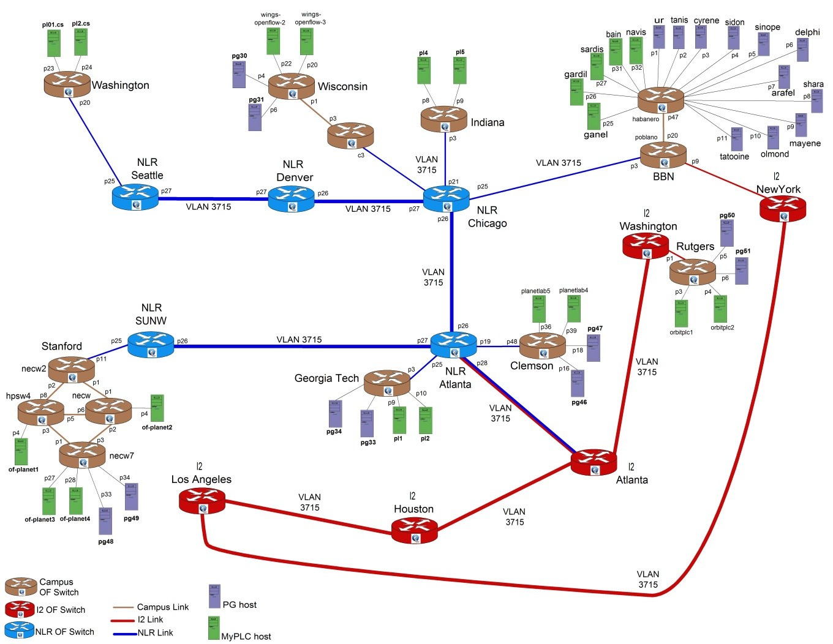
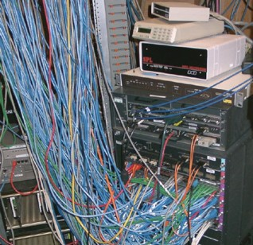
Setting
Source: http://groups.geni.net/geni/chrome/site/thumbnails/wiki/TangoGENI/OF-VLAN3715_1000.jpg
Modern networks are
increasingly more complex
outages increasingly more costly
27

Slide 28













Simple Example
Previously, an intrusion detection and prevention (IDP) device inspected all traffic to/from dorms
IDP couldn’t handle load; added bypass
IDP only inspected traffic between dorm and campus
Q: How do you know if it is acceptable?
dorm
IDP
…
bypass
Backbone
28

Slide 29
Discussion
How may you verify whether the behavior of a network (system) is acceptable?
29

Slide 30
Basic Correctness Properties
Reachability: two entities reach each other if and only allowed by policy
No want reach but does not reach
No loop
No blackhole
No want no reach but reach
No leakage among tenants
Constraints
Reachability only if pass a specified sequence of middleboxes
Consistency
Two nodes (e.g., mirrors) have exactly the same behavior
30

Slide 31
Basic Types of Approaches
Control Plane
Data Plane
execute
Data plane verification
Anteater
HSA
Veriflow
Atomic Predicates
…
Control plane verification
Batfish
Minesweeper
…
31

Slide 32




Data Plane Verification: Setting
Input: Each device has already computed its data plane (flow table)
Output: Verify that the network’s behavior satisfy given correctness properties
Destination Iface
10.1.1.0/24 & port = 80
Drop
10.1.1.128/25
v’
10.1.1.0/24
v
10.1.1.2
v
u
v
32

Slide 33
Network Verification can be Hard
Correctness (reachability): s cannot reach t
Network mechanism: assume flow table allows one-bit packet filters, e.g.,
Then: verify reachability is NP-Hard
“if p[43]
= 0 then
drop”
p[4] = 1
p[7] = 1
p[1] = 0
(x₄ _ x₇ _ x¯₁) ^ (. . .) ^ (. . .) ^ (. . .)
33

Slide 34
Look Ahead
Despite theoretical hardness, much success in practical systems
34

Slide 35
Outline
Recap
Layered architecture
what is layering?
why layering?
ISO/OSI layering and Internet layering
Network Verification
Data plane verification - Anteater
35

Slide 36
Anteater
Among the first to apply formal method (Boolean satisfiability; SAT) to network verification
Model datapath correctness requirements as Boolean expressions
Verify network properties by computing Boolean Satisfiability (e.g., use SAT tool such as Boolector)
36

Slide 37
Two-Slide SAT
Input
Given a Boolean expression P(x₁, x₂, …., x_{n}), where each x_{i} is a Boolean variable (true, false)
Goal: find an assignment to x_{i} to make P(x₁, x₂, …., x_{n}) true, e.g.,
P(x, y) = x v y
P(x, y) = x ^ !x
Ex: what if you want to verify that P(x₁, x₂, …., x _{n}) is always true
Substantial progress in SAT solvers, typically based on an approach called “systematic search.”
37

Slide 38
“Systematic” SAT Search
The search space is a tree
each vertex representing a Boolean variable
out edges representing the two choices (true and false) for this variable.
The DPLL/Davis-Putnam-Logemann-Loveland algorithm
based on 3 operations: decide, propagate, and backtrack.
benefits from a restricted representation of formulas in conjunctive normal form, or CNF, e.g., ¬p ∧ (p ∨ q)
38

Slide 39
DPLL: An Simple Demonstration

Slide 40



DP as Boolean Expressions
Define P(u, v) as the policy function for packets traveling from u to v
A packet can flow over (u, v) if and only if it satisfies P(u, v)
Destination Iface
10.1.1.0/24 v
u v
P(u, v) = dst_ip ∈10.1.1.0/24
40

Slide 41



DP as Boolean Expressions: Simpler Example
Destination Iface
0.0.0.0/0 v
u
v
P(u, v) = true
Default routing
41

Slide 42
DP as Boolean Expressions: Examples
Packet filtering
P(u, v) = (dst_ip ∈10.1.1.0/24
∧ dst_ip ∉ 10.1.1.128/25 )
∨ dst_ip ∈10.1.2.0/24
P(u, v) = dst_ip ∈10.1.1.0/24 ∧ dst_port ≠ 80
42

Slide 43



Reachability as Solving SAT
P(u,v)
P(v,w)
u
v
w
Express reachability from u to w as a Boolean condition:
u can reach w
⇔∃A packet that can flow over (u, v) and (v,w)
⇔∃A packet that makes P(u,v) ∧ P(v,w) true
⇔C = (P(u, v) ∧ P(v,w)) is satisfiable
General: one path p: for each link l in p:
P(p) = ∧_{l} P(l)
General: multiple paths p1, p2, …:
P(p1) ∨ P(p2) ∨ …
43

Slide 44
From 1 Path to M Paths
s
t
Ex: What is the Boolean expression to check reachability from s to t in the example above?
44

Slide 45
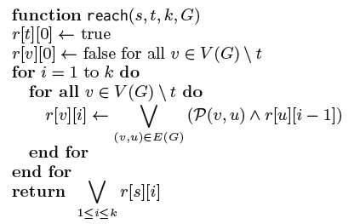
From 1 Path to M Paths
Problem: naïve enumeration of each path may need exponentially many paths
Solution: dynamic programming (a.k.a. loop unrolling)
Intermediate variables: “Can reach x in k hops?”
45

Slide 46



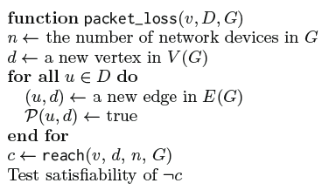


Blackhole
Black holes
lost
v
…
d₁
Ex: Generate Boolean expression to check whether there are packets originated from v but dropped without reaching any nodes of the destinations D in the network (assume no loop).
46

Slide 47









Offline Exercise
Boolean expressions to detect
u
…
w
Loop detection
u
Consistency
…
w
u’
47

Slide 48








Ex: Packet Transformation
Essential to model NAT, MPLS, QoS, etc.
dst_ip ∈
0.1.1.0/24
label = 5?
u
v
w
Solution
Model the history of packets: vector over time
Packet transformation ⇒ boolean constraints over adjacent packet versions
(p_{i}.dst ip ∈ 0.1.1.0/24) ^ (p_{i+1}.label = 5)
In general p_{i+1}= f (p_{i})
48

Slide 49
Anteater Success
Evaluated with UIUC campus network
～178 routers supporting >70,000 machines
Predominantly OSPF, also uses BGP and static routing 1,627 FIB entries per router (mean)
Result: Revealed 23 bugs with 3 invariants in 2 hours
 | Loop | Packet loss | Consistency
Being fixed | 9 | 0 | 0
Stale config. | 0 | 13 | 1
False pos. | 0 | 4 | 1
Total alerts | 9 | 17 | 2
49

Slide 50
Benefits of Anteater
First systematic application of Boolean logic to verify some common network properties
Many follow-up up applying SAT in particular and SMT (Satisfiability modulo theories) in general
Read SMT tutorial
Read Minesweeper on applying SMT to network verification
50

Slide 51
Outline
Recap
Layered architecture
what is layering?
why layering?
ISO/OSI layering and Internet layering
Network Verification
Data plane verification – Anteater
Control plane verification - Minesweeper
51

Slide 52
Control Plane Verification: Setting
Input: Each device has its configuration files (no data plane computed yet)
Output: Verify that the configurations will yield the a data plane that satisfies given correctness properties
52

Slide 53
Workflow
1.
Vendor-Specific Configs
2.
Vendor-Independent Format
Cisco
Arista
Interfaces: {
Ethernet0/0: {
InterfaceCost: 1,
importPolicy: “PEER_IN”,
…
}
}
Juniper
Parse
Encode
3.
4.
Output
Circuit Encoding
192.0.0.0 ≤ out.prefix
out.prefix ≤ 192.1.0.0
best.valid ⇒ out.lp = 120
best.valid ⇒ out.ad = 20
+ Property
Solve
Notes:
Idea: (4) useful counter-example OR verified property

Slide 54
Encoding Overview
‘‘
’’
Does P hold in the network?
N1
N2
N3
Network Encoding: N
S1
R1
R2
S2
⋀
Network Property: ¬ P
R3
Satisfiable: Property Violation
S3
Unsatisfiable: Holds for all data planes

Slide 55
Running Example
‘‘
Data plane packet
1
How does each router
forward a packet?
’’
N1
N2
N3
Symbolic Packet
{
}
0 ≤
dstIp
≤ 2³²
S1
R1
R2
S2
0 ≤
srcIp
≤ 2³²
0 ≤
dstPort
≤ 2¹⁶
???
???
0 ≤
srcPort
≤ 2¹⁶
R3
0 ≤
protocol
≤ 2⁸
S3
Notes:
At the end of the day, we care about how a packet is forwarded through the network.

Slide 56
Running Example
Protocol Interactions
2
N1
N2
N3
N1
N2
N3
Protocol
View
R1
R2
R1
R2
BGP
BGP
S1
S2
S1
CON
OSPF
OSPF
CON
S2
R3
R3
OSPF
CON
S3
S3

Slide 57
Running Example
Protocol Interactions
2
N1BGP
N1
N2
N3
Redistribution
From CON to BGP
BGP peering
Between R1 and R2
Circuit
View for R1
R1
R2
BGP
BGP
S1
CON
OSPF
OSPF
CON
S2
R1CON
R1BGP
R2BGP
R3
in4
e4
OSPF
CON
After R2
export filter
S3
R1OSPF
After R1
import filter
Notes:
Can a “routing record“ reach this point in a stable solution Define term. Black dots are routing records.

Slide 58
Running Example
Control Plane Info
3
N1BGP
Routing Record
valid:
1 bit
{
}
prefix:
[0,2³²)
prefixLen:
[0,2⁵)
R1CON
R1BGP
adminDist:
[0,2⁸)
localPref:
[0,2³²)
metric:
[0,2³²)
med:
[0,2³²)
ospfType
[0,2²)
R1OSPF

Slide 59
Running Example
R1 BGP import filter from R2
Import FIlters
4
ip prefix_list L deny 192.168.0.0/16 le 32
ip prefix_list L allow
route-map R1_Import_From_R2 10
match ip address prefix-list L
set local-preference 120
N1BGP
SMT constraint
If R2 exports a route
if e4.valid ∧ failedR1,R2 = 0 then if ¬ (FBM(e4.prefix, 192.168.0.0, 16) ∧
16 ≤ e4.prefixLen ≤ 32) then
in4.valid = true in4.lp = 120 in4.prefix = e4 .prefix
in4.metric = e4.metric
in4.prefixLen = e4 .prefixLen
…
else in4.valid = false
else in4 .valid = false
R1CON
If it passes the import filter
R1BGP
R2BGP
in4
e4
Then R1 has the same
route with local-pref 120
R1OSPF
Otherwise, R1 does not
have a route from R2

Slide 60
Running Example
Decision Process
5
N1BGP
What is the best BGP route?
R1-BGP-BEST = Min(in1, in4, in5, in7)
in1
in7
What is the best overall route?
R1CON
R1BGP
R2BGP
R1-BEST = Min(R1-BGP-BEST
in4
R1-OSPF-BEST
in5
R1-CON-BEST)
R1OSPF

Slide 61
Running Example
Decision Process
5
N1BGP
Does R1 have a RIB entry for R2?
RIB_{R1,R2} = (in4 = R1-Best)
R1CON
R1BGP
R2BGP
Does R1 have a FIB entry for R2?
e4
FIB_{R1,R2} = RIB_{R1,R2} ⋀ ¬ ACL(R1,R2)
in4
R1OSPF

Slide 62
Supported Features
Features
Implemented
Continued…
OSPF Intra-area
iBGP
OSPF Inter-area
Route Reflectors
eBGP Local-pref
Static Routes
eBGP Communities
Route Redistribution
eBGP MEDs
Multipath Routing
eBGP Path Prepending
Access Control Lists
eBGP Aggregation
IPV6

Slide 63
Property: Reachability / Isolation
‘‘
’’
Can router R3 (not) reach subnet S2?
N1
N2
N3
canReach_{R2} ⇔ FIB_{R2,S2}
canReach_{R1} ⇔
(FIB_{R1,R2} ⋀ canReach_{R2}) ⋁
(FIB_{R1,R3} ⋀ canReach_{R3})
S1
R1
R2
S2
canReach_{R3} ⇔
(FIB_{R3,R1} ⋀ canReach_{R1})
R3
Property: canReach_{R3}
S3
Notes:
Emphasize, reachability here is for all possible data planes

Slide 64
Supported Properties
Reachability
Waypointing
Isolation
Path Length
2
1
0

Slide 65
Supported Properties
Disjoint Paths
Black Holes
Forwarding Loops
Multipath Consistency
D
S

Slide 66
Supported Properties
Load Balancing
Fault-Invariance
.4
.6
Router Equivalence
Network Equivalence
=

Slide 67
Evaluation
Can Minesweeper find real bugs?
Run on a collection of 152 legacy networks
1—23K lines of configuration
Use OSPF, eBGP, iBGP, Static Routes, ACLs, Redistribution
How well does Minesweeper scale?
Test on a collection of synthetic data center benchmarks
Compare verification time across a wide variety of properties

Slide 68
Evaluation: Bug Finding
Mangement interface reachability
Loopback0
Found 67 violations of the property
Example: BGP peer sends /32 with length 2
Local equivalence of routers
Found 29 violations
Example: ACL has missing entry
Blackholes occur only at the network edge
Found 24 violations of the property
Reachability is the same after any 1 failure
Found no violations of the property

Slide 69
Evaluation: Scalability
Management interface reachability
< 60 ms
Local equivalence of routers
(For all n comparisons)
< 400 ms

Slide 70
Evaluation: Scalability
Black holes only occur
at the network edge
< 1.5 sec
Reachability is the same after
any single link failure
< 350 ms

Slide 71
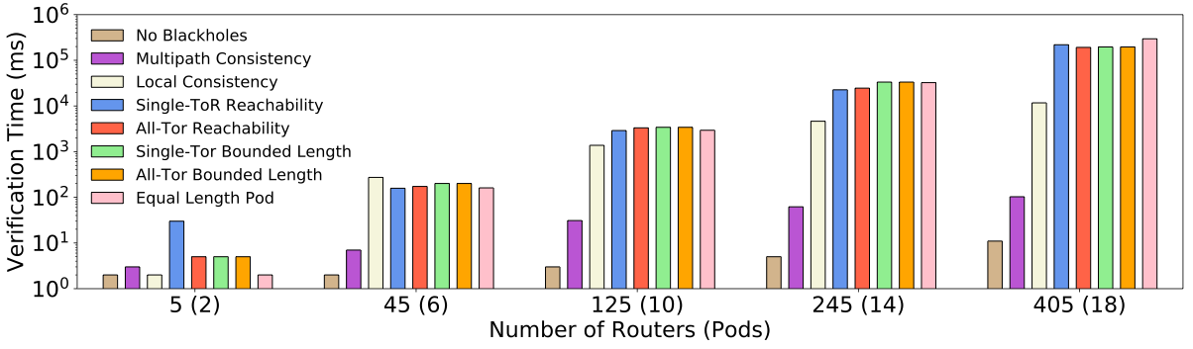
Evaluation: Scalability
< 5 minutes

Slide 72
Discussion
Limitations of modeling using only SAT/SMT?
72

Slide 73
Thanks
Instructor: Qiao Xiang
Contact: qiaoxiang@xmu.edu.cn

